Slide 1
Linear Algebra
线性代数
Zongbin Chen YMSC, Tsinghua University
陈宗彬 清华大学数学科学中心
Email: zbchen@tsinghua.edu.can

Slide 2


Quick review
Sub vector space(子向量空间）

Slide 3
Linear combination of vectors(向量的线性组合)
Linear span of vectors

Slide 4
Matrix equation and linear combination of vectors
Three equivalent problems

Slide 5
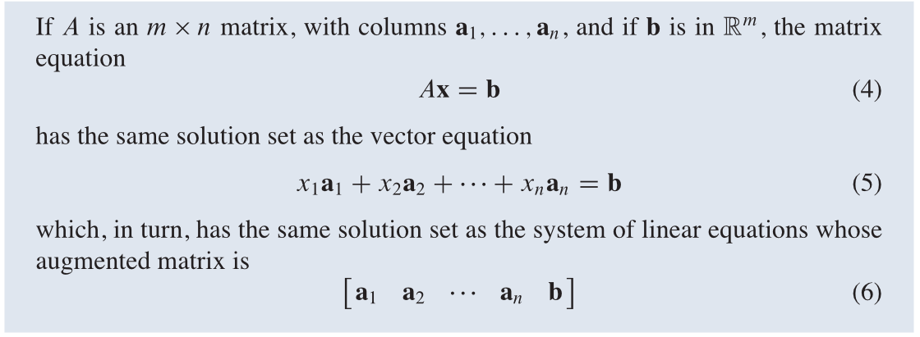

Theorem: The above three equations has the same set of solution. More precisely,

Slide 6
Example

Slide 8
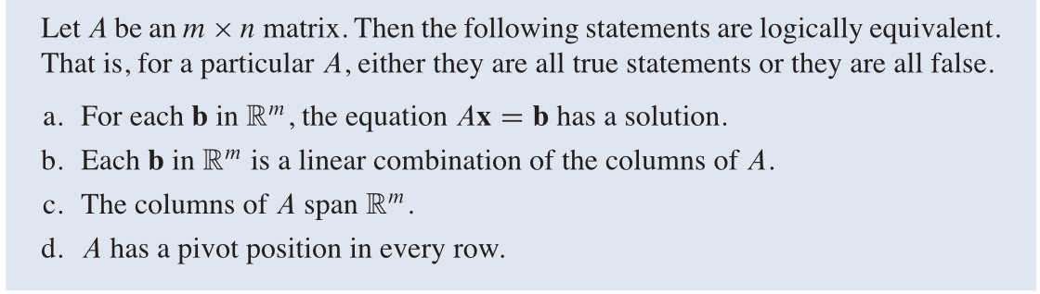
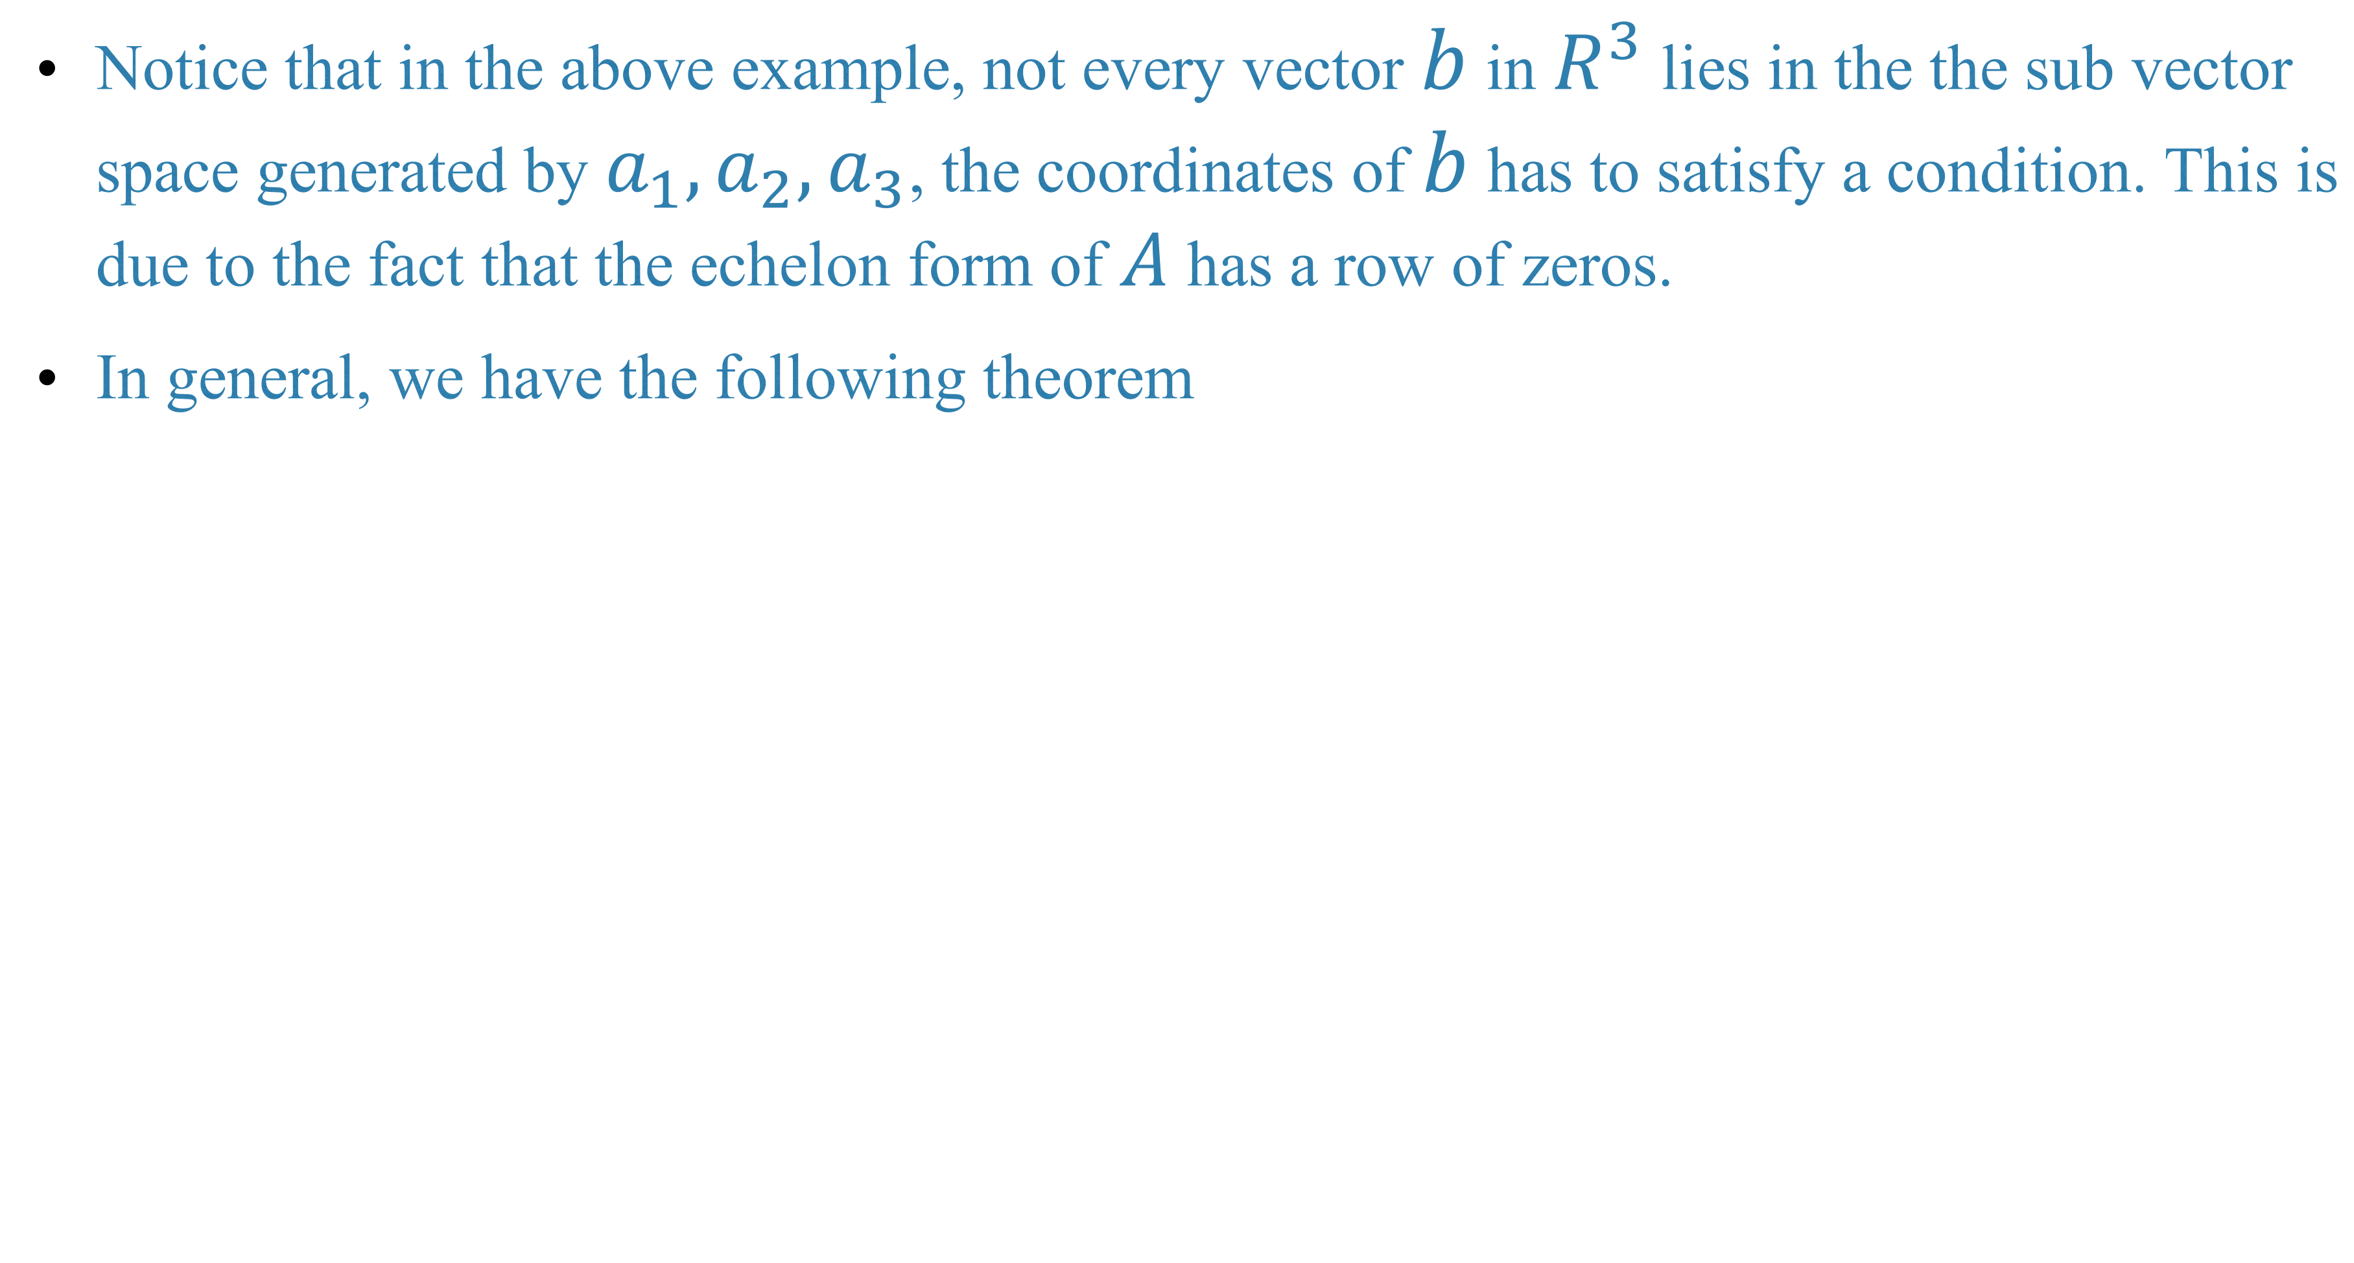
Notice that in the above example, not every vector $b$ in $R^{3}$ lies in the the sub vector space generated by $a_{1},a_{2},a_{3}$, the coordinates of $b$ has to satisfy a condition. This is due to the fact that the echelon form of $A$ has a row of zeros.
In general, we have the following theorem

Slide 9
Example

Slide 10
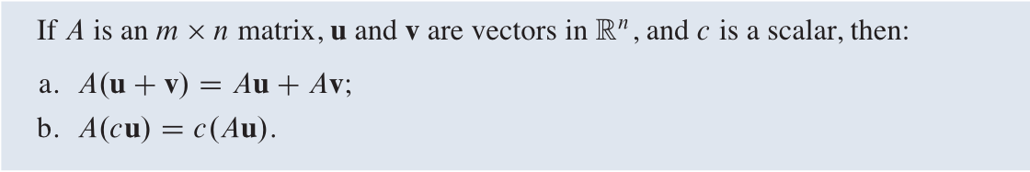
Property of matrix-vector product
In other words, matrix multiplication preserve vector addition and scalar multiplication.

Slide 12
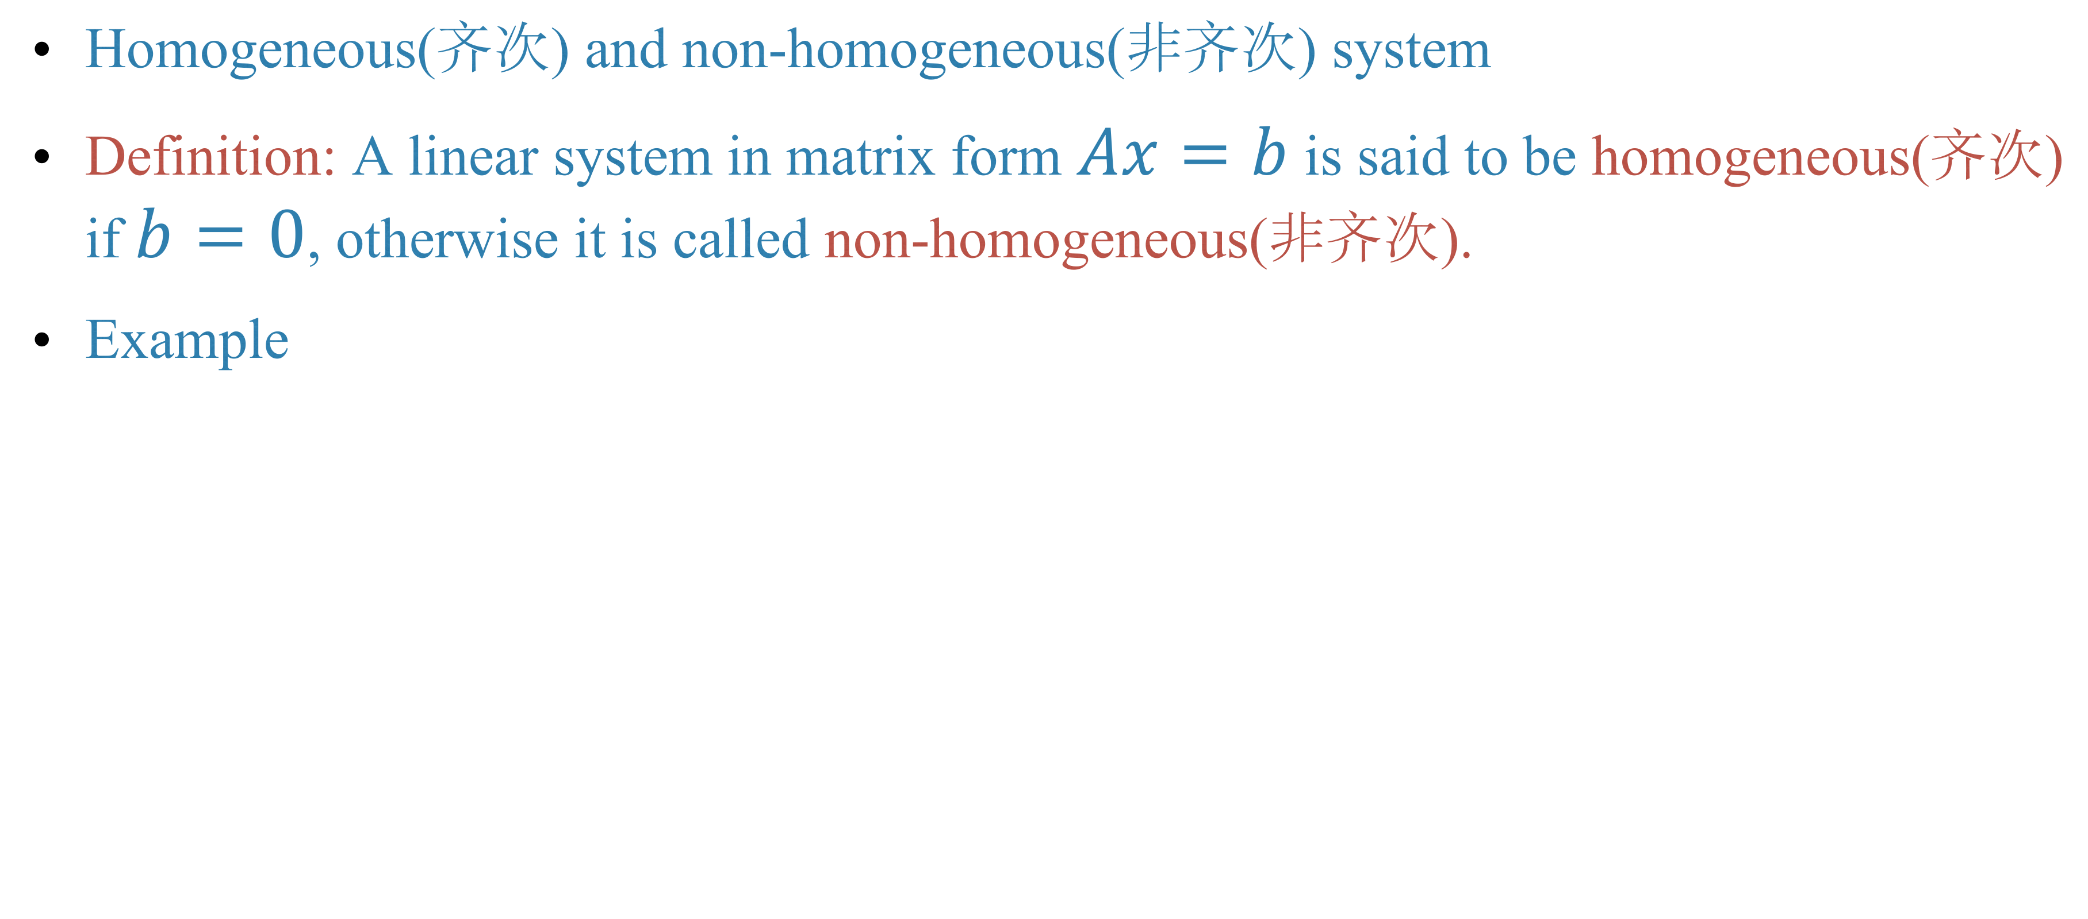
The structure of the set of solution of a linear system
Homogeneous(齐次) and non-homogeneous(非齐次) system
Definition: A linear system in matrix form $Ax=b$ is said to be homogeneous(齐次) if $b=0$, otherwise it is called non-homogeneous(非齐次).
Example

Slide 13
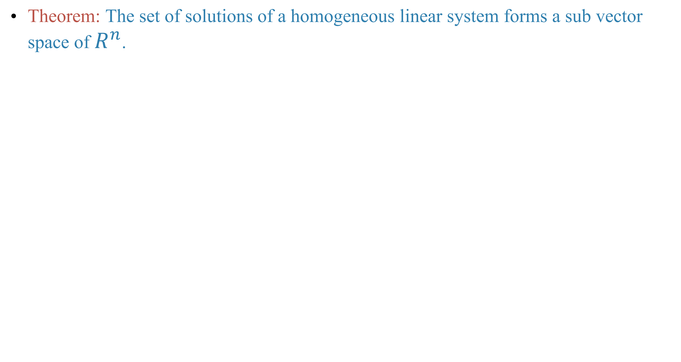
Theorem: The set of solutions of a homogeneous linear system forms a sub vector space of $R^{n}$.

Slide 14
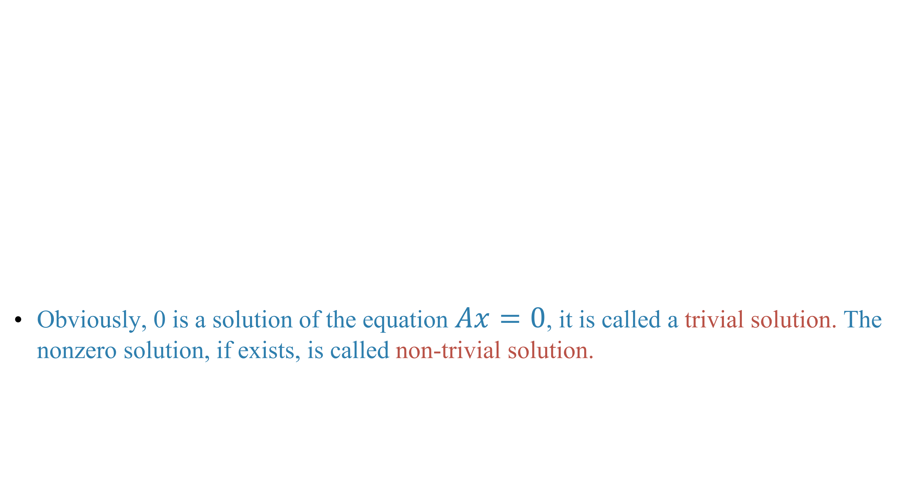
Obviously, 0 is a solution of the equation $Ax=0$, it is called a trivial solution. The nonzero solution, if exists, is called non-trivial solution.

Slide 15
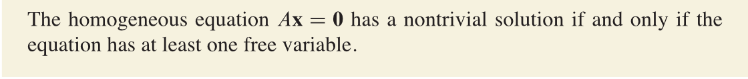
Theorem

Slide 16
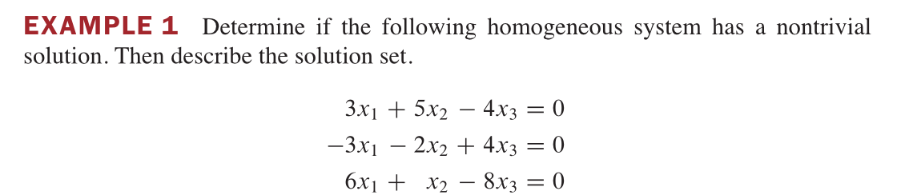

Slide 17
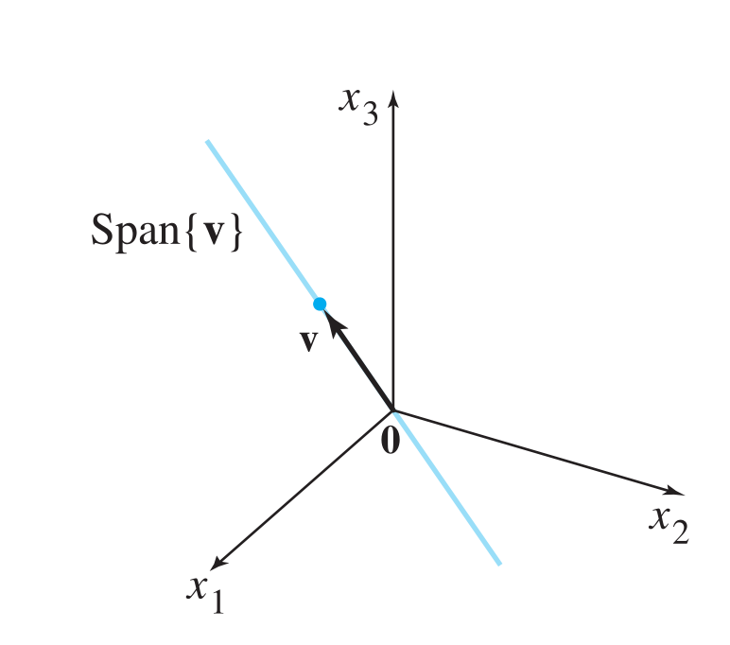

Slide 18
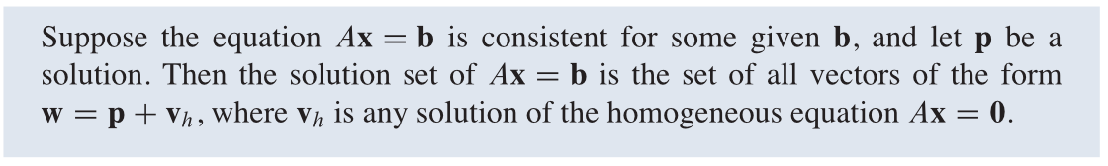
Solutions of non-homogeneous system
Theorem

Slide 19
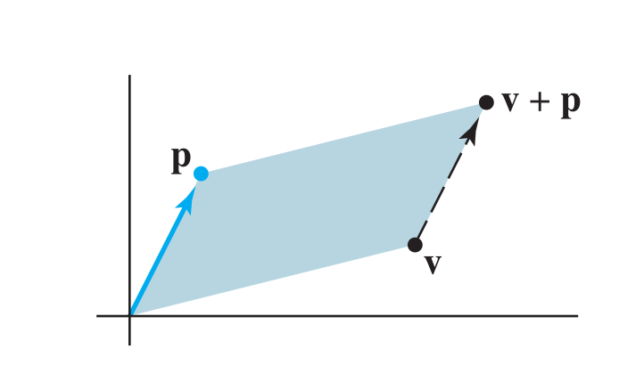
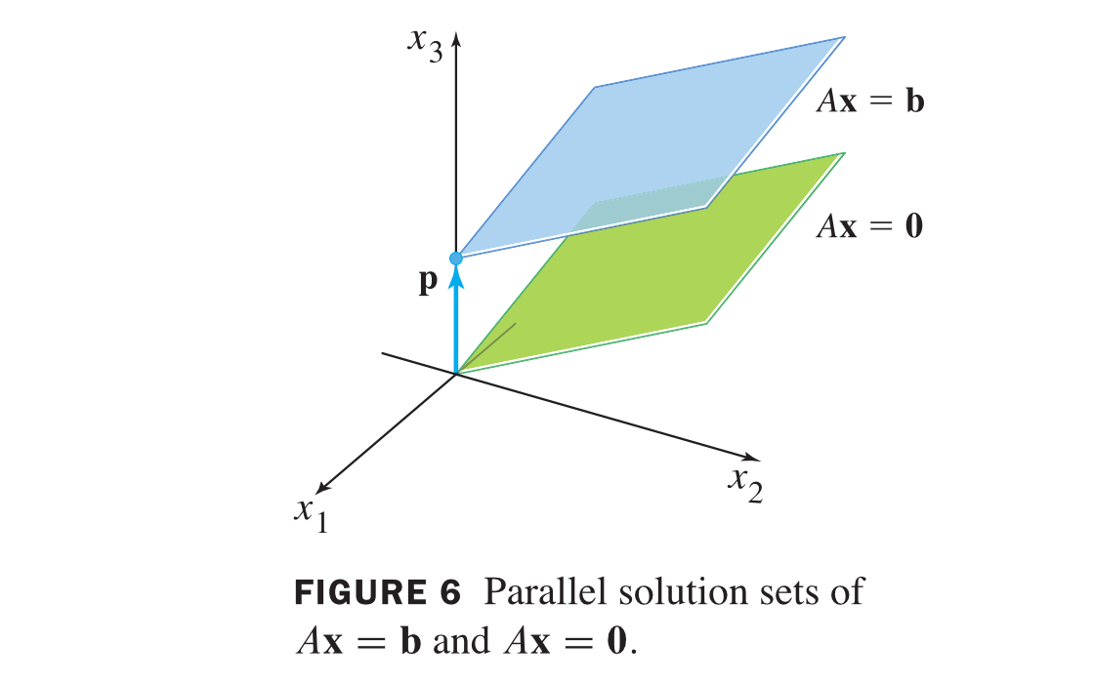
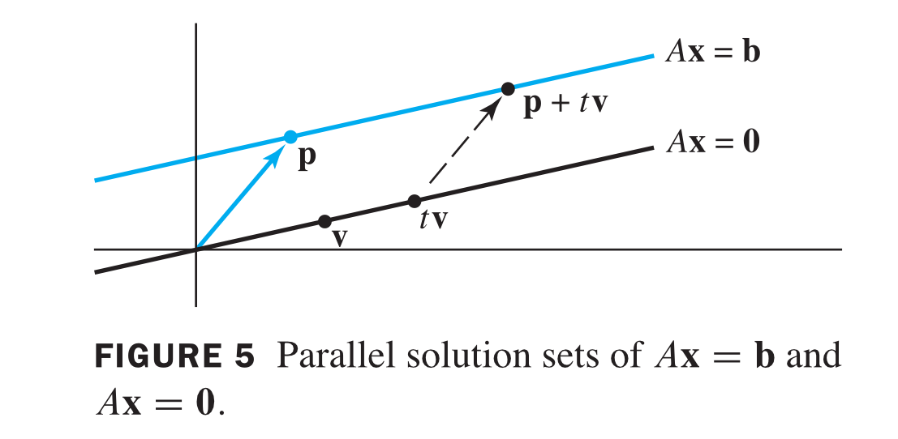
Geometric meaning

Slide 20
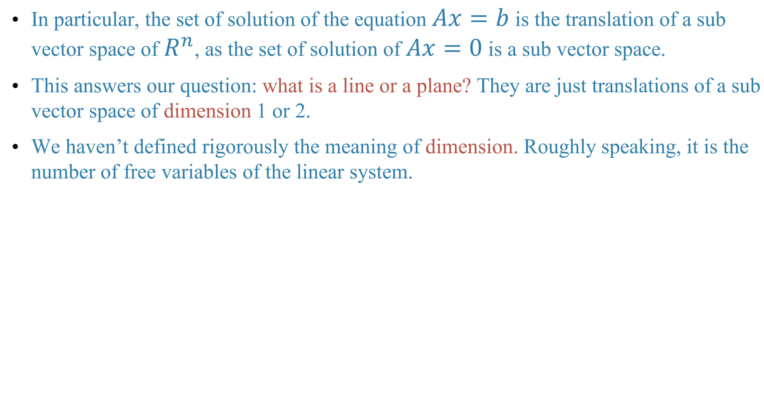
In particular, the set of solution of the equation $Ax=b$ is the translation of a sub vector space of $R^{n}$, as the set of solution of $Ax=0$ is a sub vector space.
This answers our question: what is a line or a plane? They are just translations of a sub vector space of dimension 1 or 2.
We haven’t defined rigorously the meaning of dimension. Roughly speaking, it is the number of free variables of the linear system.

Slide 21
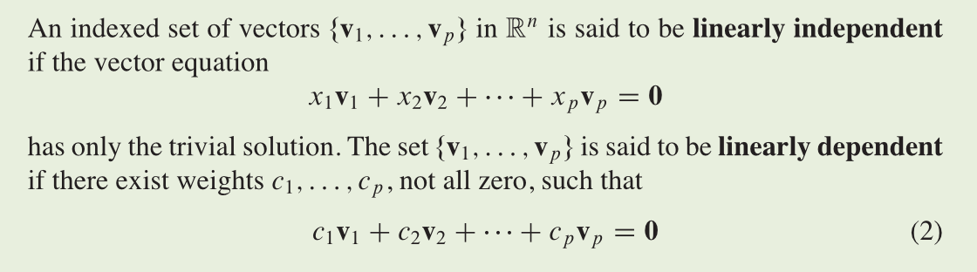
Linear independence of vectors
Definition: linear independent(线性无关), linear dependent(线性相关)

Slide 22
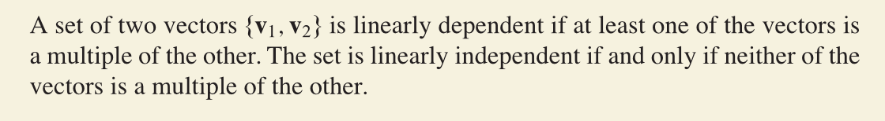
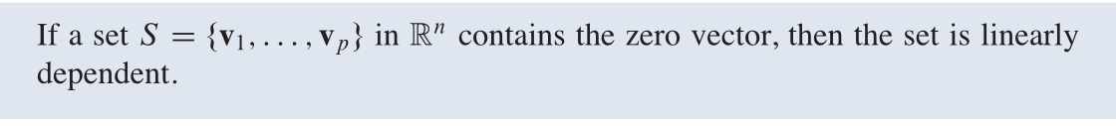
Example
Example

Slide 23
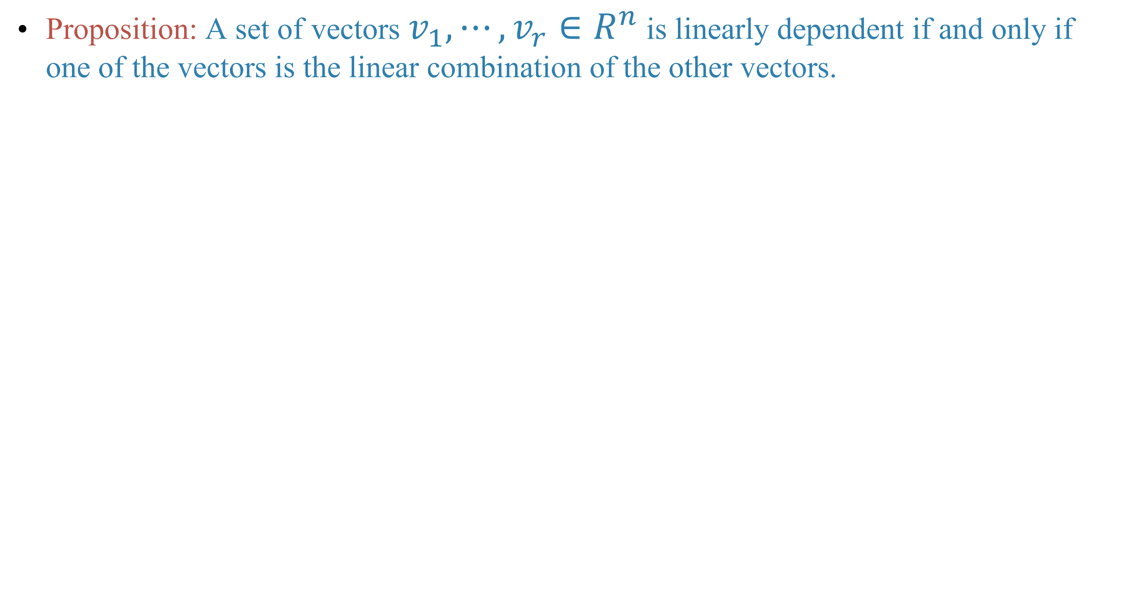
Proposition: A set of vectors $v_{1},⋯,v_{r}∈R^{n}$ is linearly dependent if and only if one of the vectors is the linear combination of the other vectors.

Slide 25
Relations with homogeneous linear system

Slide 26
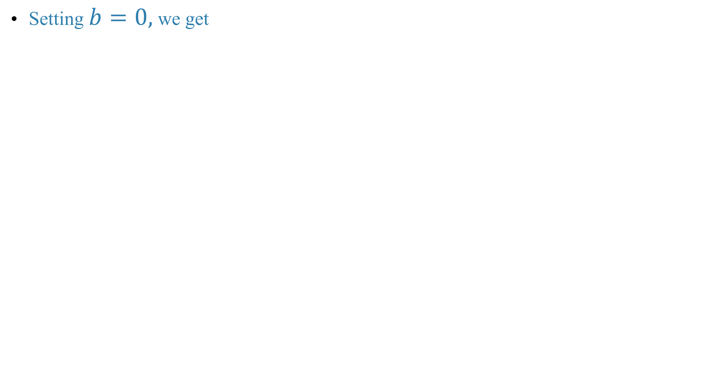
Setting $b=0,$ we get

Slide 27
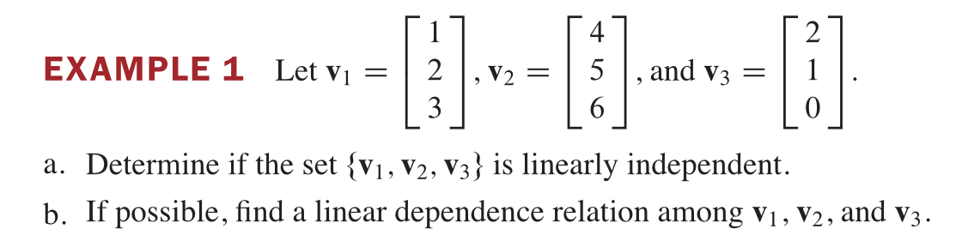

Slide 29
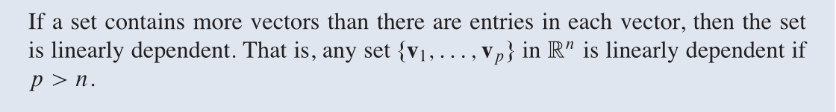
Theorem

Slide 30
Homework
Lay-Lay-McDonald, 1.5 Exercises, question 6, 16.

Slide 31
Next time
Lay-Lay-McDonald, 1.7
Gilbert Strang, chapter 3, section 3.4.

